Slide 1
Airframes
Chapter 6: Hydraulics & Pneumatics

Slide 2
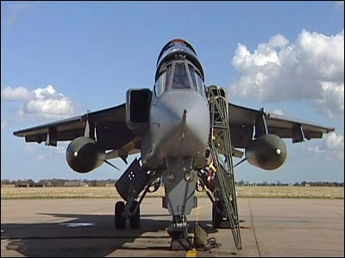

Slide 3
Learning Objectives
The purpose of this chapter is to provide a basic introduction to the principles of hydraulics & pneumatics and their application within the airframe.
So, by the end of this presentation you will be able to identify the main components of an aircraft hydraulic system, the use of pneumatics and recognise their function.
But first a recap of Chapter 5 with some questions.

Slide 4
Chapter 5 Revision
A couple of questions about the previous chapter.
Name 2 components found in a wing?
What do we call the type of construction where the skin takes a proportion of the loading in the airframe?
Most modern large aircraft use two main spars, with stressed skin between them, what is this type of construction called?

Slide 5
Introduction
The term ‘hydraulics’ refers to the power produced in moving liquids.
Hydraulic power in the form of water wheels and other simple devices has been in use for centuries, but it wasn’t until the 17th Century that the principles of hydraulics were formulated into scientific law.
Modern hydraulic systems are defined as;
The use of confined liquids to transmit power, multiply force or produce motion efficiently.

Slide 6
Pascal’s Law
The French mathematician & philosopher, Blaise Pascal, discovered that liquids cannot be compressed.
His work on hydraulics led to him publishing the following law concerning confined fluids;
"a change in the pressure of an enclosed incompressible fluid is conveyed undiminished to every part of the fluid and to the surfaces of its container."
In other words, if a pressure is applied on a confined fluid, this pressure is transmitted in all directions with equal force on equal areas.

Slide 7
The Law in Practice
A full bottle of washing up fluid has a 1 Sq.Ins opening.
If we then apply 10 lbs of force through the cap…….
……Then 10 lbs of force would be equally applied to all sides of the bottle by the fluid in the bottle
The fluid pressure within the bottle is expressed as 10 psi (pounds per square inch).
10 lbs
1 Sq.Ins
10 psi

Slide 8
Basic Hydraulic System
A ‘Basic’ hydraulic system provides a mechanical advantage similar to that of a simple lever.
By using cylinders of different sizes a Multiplication of Forces can be achieved

Slide 9
Multiplication of Forces
In the previous example, the small force of 100 lbs exerted on the 2 inch diameter cylinder was seen to move the large weight of 900 lbs on the 6 inch diameter cylinder.
The distance the 900 lbs will travel is inversely proportional to the distance the applied force travels.
This means that if we move the piston in the 2 inch diameter cylinder a distance of 1 inch, the distance that the piston in the 6 Ins diameter cylinder will move is 1/9th of an inch.
As the pressure within both cylinders must be the same, Pascal’s Law shows the way in which the input force can be multiplied as an output force just by varying the area of the pistons!

Slide 10
Advantages of Hydraulics
There are many advantages to utilising hydraulic systems within airframe design.
The system is often lighter in weight than a mechanical system and have a low installation space requirement – hence ideal for being buried within the airframe.
Hydraulic systems can develop almost unlimited force or torque
They are generally reliable: They either work or they do not work!
They are easy to maintain and are considered repair-friendly.
They are smooth and responsive to operator inputs i.e. little or no delay (or lag).

Slide 11
Airframe Hydraulics
Which parts of the airframe do you think are powered by or use a hydraulic system?
Undercarriage Retraction (and Extension)
Primary Flight Controls
Wing Variable Geometry
Flaps
Braking System
Spoilers
Access Hatches
Shock Absorption

Slide 12
Typical Hydraulic System
Although the layout and complexity of a hydraulic system will vary based on it’s primary function, the principles and components of the system will be the same.
Typically, a hydraulic system will consist of;
The Hydraulic Fluid
A Reservoir
A Hydraulic Pump
Hydraulic Fluid Lines
A number of Hydraulic Valves
A number of Hydraulic Actuators

Slide 13
Typical Layout
The diagram below shows a typical layout of components in a Hydraulic System.
Actuator
Reservoir
Low Pressure Return
Selector Valve
POWER
Pressure Line
Pump

Slide 14
Hydraulic Fluid
The fluid used within the hydraulic system can be almost any liquid.
However, the most common hydraulic fluids contain specially compounded petroleum oils.
These lubricate and protect the system components from corrosion.

Slide 15
Reservoir
The reservoir is no more than a tank that acts as a storehouse for the fluid.
The reservoir also acts as a heat dissipater – ensuring that the oil remains at the optimum temperature.
If the oil gets too hot, it’s properties change and the fluid will become more viscous.
If the properties of the hydraulic fluid change, this can affect the responsiveness of the system.

Slide 16
The Hydraulic Pump
The hydraulic pump allows the conversion of mechanical energy into hydraulic energy by forcing the hydraulic fluid, under pressure, from the reservoir, through a filter into the system.
In a piston-engine and gas-turbine powered aircraft, the pump is usually mounted to the engine gearbox.
The type of pump used will be dependent on the application, but ‘Gear Pumps’, ‘Vane Pumps’ and ‘Piston Pumps’ are the three types of pumps typically utilised.

Slide 17
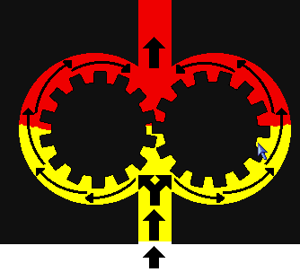
Gear & Vane Pumps
Gear and Vane pumps move fluid based upon the number of gear teeth or vanes and the volume spacing between gear teeth or vanes.
As the liquid comes from the reservoir, it is pushed between the gear teeth or vanes.
The oil is moved around to the other side by the action of the pump and sent through the pressure line.
Gear pumps have efficiencies that average about 70-80% overall efficiency.

Slide 18
Piston Pump
There are two types of Piston Pump utilised within hydraulic systems – Radial and Axial.
The Radial Piston Pump has pistons that move perpendicular to the pump axis
Axial Piston Pumps move parallel to the axis of rotation – the pistons are contained within a rotating cylinder barrel
They have the advantage of being more compact in design. The pumps are easier and more economical to manufacture.
A disadvantage is that they are more sensitive to oil contamination.

Slide 19
Hydraulic Fluid Lines
The hydraulic fluid lines transport the hydraulic fluid to and from the pump through to all the components of the hydraulic system.
These lines can be rigid metal tubes, or flexible hose assemblies.
The fluid lines can transport fluid either under pressure or via vacuum (i.e. suction).

Slide 20
Hydraulic Selector Valves
The hydraulic selector valves are used to control the pressure, direction and flow rate of the hydraulic fluid within the hydraulic system.
There are a number of different types of selector valve in use – a common type is the Open Centre Spool Valve.

Slide 21
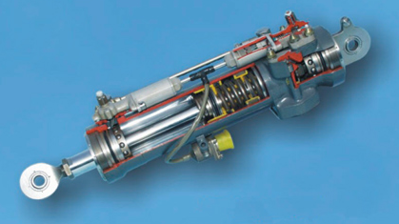
Hydraulic Actuators
The hydraulic actuator converts hydraulic energy into mechanical energy to do work.
The actuators usually take the form of hydraulic cylinders with a piston that allows the hydraulic ram to move in and out.
In an airframe, they will be used to move the flight controls, lower and retract the undercarriage, deploy the high lift devices, etc.

Slide 22
Special Problems
The extreme flexibility of hydraulic systems present a number of problems
Since hydraulic fluid has no shape, they must be positively confined throughout the entire system.
Special consideration to the structural integrity of the system must be given – i.e. Strong pipes and containers
Leaks must be prevented – a particular problem with the high pressures involved.
The constant movement of the fluid in the system results in friction within the fluid and hence a reduction in efficiency.
Foreign matter must not be allowed to accumulate in the system.
Chemical action may cause corrosion of the system components

Slide 23
Pneumatic Systems
Pneumatic systems work in a very similar way to that of hydraulic systems.
The major difference is that in pneumatic systems, high pressure air is used instead of hydraulic fluid.
This is because air is much more compressible than fluid and it is much easier to store the pressure, using reservoirs.
This can give a reserve of power for short bursts of very heavy operation, or for emergency use if the system fails.
In an airframe, a pneumatic system can be used in place of a hydraulic system

Slide 24
Typical Pneumatic System
Like the hydraulic system, the layout and complexity of a pneumatic system will vary based on it’s primary function, but the principles and components of the system will be the same.
Typically, a pneumatic system will consist of;
A Storage Cylinder – for the compressed air
Pressure Gauges
Pressure Valves – Non-Return, Reducing, Maintaining
Pneumatic Air Lines
A number of Pneumatic Selector Valves
A number of Pneumatic Actuators

Slide 25
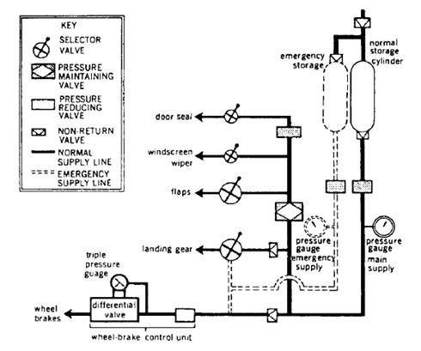
Typical Layout
The diagram below shows a typical layout of components in a Pneumatic System.

Slide 26
Disadvantages of Pneumatics
However, the compressibility of air can be a major disadvantage, as pneumatic systems lack the instant response that a simple hydraulic system can provide.
The rate of movement of pneumatic actuators depends strongly on the load, or the force which resists the movement.
This compressibility also means that the position of systems needing partial movements, such as control surfaces, cannot be controlled with any degree of accuracy.

Slide 27
Disadvantage of Pneumatics
Another major disadvantage of using pneumatic systems is the relative inefficiency in transmitting power in comparison with hydraulic systems
This is because energy is lost in compressing the air, a problem that does not occur with hydraulic fluid.
Because of these major disadvantages, many aircraft are not fitted with a pneumatic system.

Slide 28
Conclusions
You should now have a basic understanding of the hydraulic & pneumatic systems, their components and the areas where they are used on the airframe.
The hydraulic & pneumatic systems are simple, yet efficient means of transmitting power and/or motion
Any Questions?

Slide 29
Questions
Here are some questions for you!
Name the main components of the Hydraulic System?
What are the two main types of power pump used within the Hydraulic System?
What does Pascal’s Law state about the compressibility of fluids?
Name the main components of the Pneumatic System?

